Slide 1
UNIVERSITY OF PITTSBURGH
Board of Trustees
Joint Budget and Executive Committee Information Meeting
July 13, 2021

Slide 2
Agenda
      Fiscal Year 2022 Proposed Operating Budget
      Fiscal Year 2022 Proposed Capital Budget

Slide 3
Fiscal Year 2022 Proposed
Operating Budget
Hari Sastry

Slide 4
FY 2021 Proposed E&G Budget Summary
Tuition
2.5% base increase for undergrad and grad students
2.0% additional increase for out-of-state undergrads, excluding Engineering
2.0% additional increase for all undergrad School of Computing & Information students
Regional campuses – 1.5% increase
Key Initiatives
Equity, Diversity & Inclusion
Strengthening Recruitment and Retention of Students
Operational Improvements
Compensation
Total of 1.25% in salary increases
  Progressively tiered salary increases of 1% based on income
  0.25% for merit, market and equity
Budget Reduction
1% reduction to balance the budget

Slide 5
Historical Commonwealth Appropriation

Slide 6
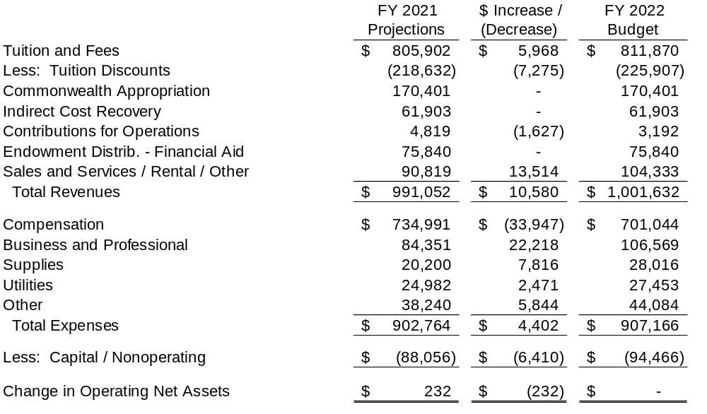
(in thousands)
Proposed FY 2022 Unrestricted E&G Budget
- The working capital loan associated with the Pitt Success program, debt service transfers, and funded depreciation are included in Capital / Nonoperating.

Slide 7
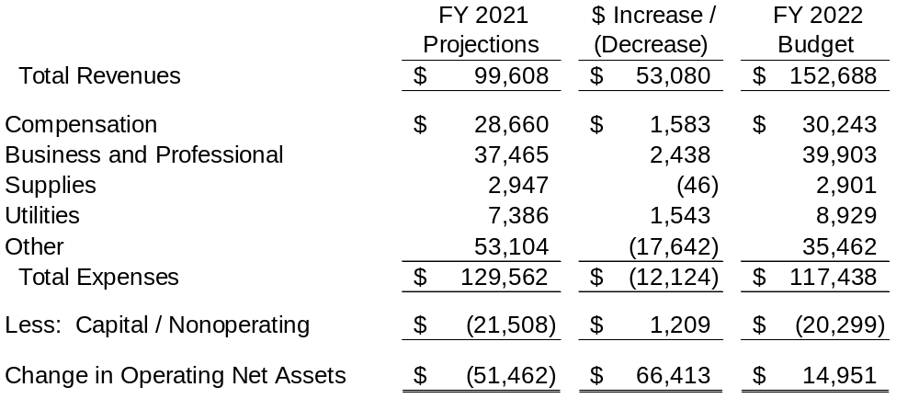
Proposed FY 2022 Auxiliaries Budget
(in thousands)

Slide 8
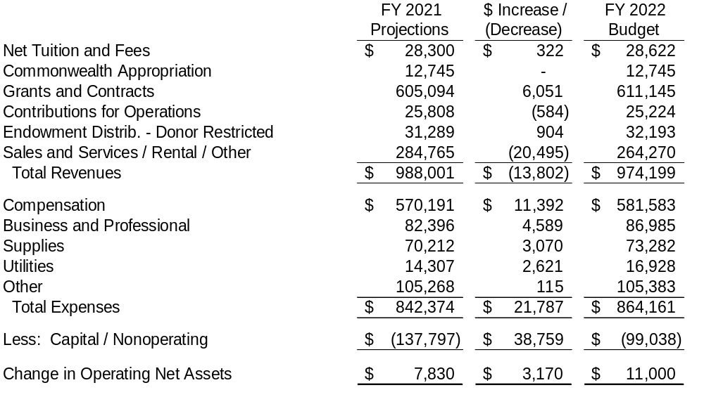
Proposed FY 2022 SOMD Budget
(in thousands)

Slide 9
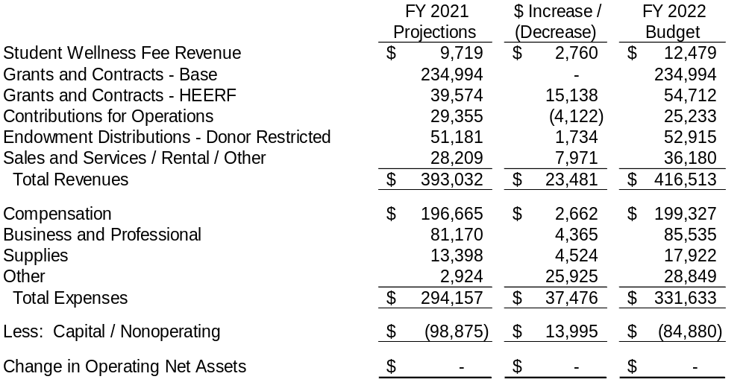
Proposed FY 2022 E&G Restricted / Research Budget
(in thousands of dollars)

Slide 10
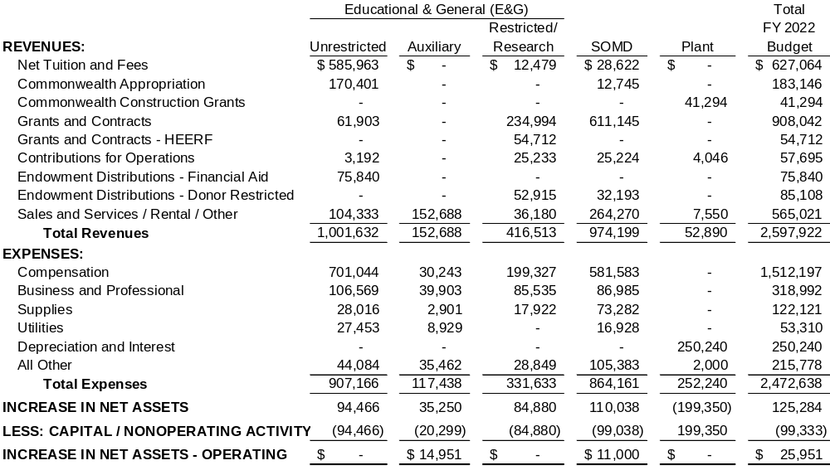
(in thousands)
FY 2022 Proposed University Budget

Slide 11
Status of the Fiscal Year 2022
Capital Budget
David DeJong

Slide 12
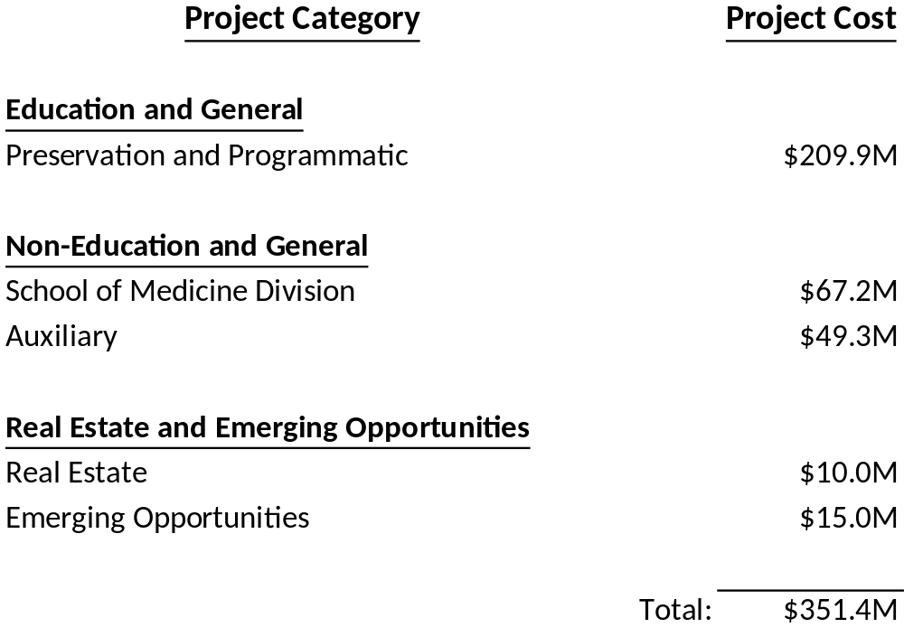
FY 2022 Proposed Capital Budget Summary

Slide 13
Proposed Capital Budget – FY 2022
Projects | Amount
Auxiliaries Projects (Housing, Repair, Renovation & Design) | $49 Million
Construct New Student Recreation and Wellness Center | $40 Million
Construct New Chilled Water Plant | $39 Million
Renovate Hillman Library | $31 Million
Renovate Alan Magee Scaife Hall West Wing | $30 Million
Construct New Engineering Bldg Bradford | $23 Million
Other (<$15M projects) | $114 Million
Total Before Emerging Opportunities and Real Estate | $326 Million
Emerging Opportunities and Real Estate | $25 Million
FY 2022 Total Proposed Capital Budget | $351 Million

Slide 14
Capital Budget Historical Trend
$640M
Projected
$ Millions
$339M
$351M
$209M
$140M
$110M
$68M
$76M

